Slide 1
COMP 3400
Week 7 - Monday

Slide 2
Last time
What did we talk about last time?
Socket programming
IPv4 and IPv6 addressing

Slide 3
Questions?

Slide 4
Assignment 4

Slide 5
Project 2

Slide 6
Back to Sockets

Slide 7
Getting addresses from a host name
DNS converts a host name to an IP address
The getaddrinfo() function lets us get a linked list of matching addresses
The only annoying bit is that we have to fill out a hints structure
A utility function freeaddrinfo() is provided to free the linked list structure when done with it
int getaddrinfo (const char *name, const char *service,
const struct addrinfo *hints, struct addrinfo **results)
void freeaddrinfo (struct addrinfo *info);

Slide 8
The addrinfo struct
The result of getaddrinfo() is stored into the pointer given by the last argument
struct addrinfo {
int ai_flags;
int ai_family;
int ai_socktype;
int ai_protocol;
socklen_t ai_addrlen;
char *ai_canonname;
struct sockaddr *ai_addr; // Pointer to address we need
struct addrinfo *ai_next; // Pointer to next addrinfo in linked list
};

Slide 9
Getting address example
struct addrinfo hints, *server_list = NULL, *server = NULL;
memset (&hints, 0, sizeof (hints));
hints.ai_family = AF_INET; // IPv4
hints.ai_socktype = SOCK_STREAM; // Byte-streams (TCP)
hints.ai_protocol = IPPROTO_TCP; // TCP
assert (getaddrinfo (hostname, "http", &hints, &server_list) == 0); // Get addresses
for (server = server_list; server != NULL; server = server->ai_next)
{
if (server->ai_family == AF_INET) // Only take IPv4
{
// Cast to IPv4 socket
struct sockaddr_in *addr = (struct sockaddr_in *)server->ai_addr;
printf ("IPv4 address: %s\n", inet_ntoa (addr->sin_addr));
}
}
freeaddrinfo (server_list);

Slide 10
Confusing structs!
Here's a visualization of the addrinfo and sockaddr structs that might come back from getaddrinfo()
struct addrinfo
ai_flags | …
ai_family | AF_INET
ai_socktype | SOCK_STREAM
ai_protocol | IPPROTO_TCP
ai_addrlen | 4
ai_canonname | …
ai_addr
ai_next
struct addrinfo
ai_flags | …
ai_family | AF_INET6
ai_socktype | SOCK_STREAM
ai_protocol | IPPROTO_TCP
ai_addrlen | 16
ai_canonname | …
ai_addr
ai_next | NULL
struct sockaddr_in6
sin6_family | AF_INET6
sin6_port | 80
sin6_flowinfo | …
sin6_addr | 2606:2800:220:1: 248:1893:25C8:1946
sin6_scope_id | …
struct sockaddr_in
sin_family | AF_INET
sin_port | 80
sin_addr | 93.184.216.34
sin_zero | 0

Slide 11
Programming practice
Adapt the code on the previous slide:
  Read a host or IP address from the user
  Read a service or port name from the user
  Print out the resulting IP addresses
Note the following common port names and services:
Port | Name | Service |  | Port | Name | Service
21 | FTP | Insecure file transfer |  | 110 | POP3 | POP email access
22 | SSH | Secure shell |  | 123 | NTP | Time synchronization
23 | Telnet | Insecure remote access |  | 143 | IMAP | IMAP email access
25 | SMTP | Email delivery |  | 194 | IRC | Internet chat service
53 | DNS | IP address lookup |  | 389 | LDAP | Authentication
67 | DHCP | IP address assignment |  | 443 | HTTPS | Secure web page
68 | DHCP | IP address assignment |  | 530 | RPC | Remote procedure call
80 | HTTP | Web page |  | 631 | IPP | Internet printing
88 | Kerberos | Authentication |  | 993 | IMAPS | Secure IMAP access

Slide 12
Client side: connecting
After all the madness is done getting the sockaddr, a client can connect to a listening server with the connect() function
The connect() function is a blocking call that will eventually succeed or fail to connect the socket file descriptor to an actual network connection
If successful, we can read and write from that file descriptor
int connect (int socket, const struct sockaddr *address, socklen_t address_len);

Slide 13
Server side: options
The server side is more complicated
It's useful to set some options on the socket using the (confusing) setsockopt() function
  Reusing the port, allowing reuse of the same port, even after crashing
  Timing out on read messages
After creating the socket:
int setsockopt (int socket, int level, int option, const void *value, socklen_t lengeth);
//Allow port reuse
int on = 1;
setsockopt (socketfd, SOL_SOCKET, SO_REUSEADDR, (const void *) &on, sizeof (int));
// Set a 5-second timeout when waiting to receive
struct timeval timeout = { 5, 0 };
setsockopt (socketfd, SOL_SOCKET, SO_RCVTIMEO, (const void *) &timeout,
sizeof (timeout));

Slide 14
Server side: binding and listening
After creating the server socket (and maybe setting options), the next step is to bind the server to a port
For UDP, the server is then ready to receive messages
For TCP, it has to listen on the socket
  The backlog gives how many clients can queue up when trying to connect to the server
int bind (int socket, const struct sockaddr *address, socklen_t address_len);
int listen (int socket, int backlog);

Slide 15
Server side: accepting
For TCP connections, after listening, the server can call accept()
  Blocking function
  Will wait until a client tries to connect
  Then, messages can be sent and received
  Doing so sets up a TCP session, expecting a series of packets from the connecting client
int accept (int socket, struct sockaddr *address, socklen_t *address_len);

Slide 16
TCP
Communication
Server
Client
socket()
socket()
bind()
listen()
accept()
connect()
recvfrom()
sendto()
Repeat until done
sendto()
recvfrom()
close()
close()

Slide 17
UDP
Communication
Server
Client
socket()
socket()
bind()
connect()
recvfrom()
sendto()
Repeat until done
sendto()
recvfrom()
close()
close()

Slide 18
TCP Socket Programming

Slide 19
TCP communication
The biggest differences between single-machine and networked IPC:
  Networked IPC typically employs protocols so that machines agree on how data should be formatted
  Networked IPC is less reliable
It's hard to talk about TCP communication without examples that use some particular application layer protocol
We're going to use HTTP because:
  It's easy to understand
  It's really important
  There are lots of servers in the world we can talk to without any credentials

Slide 20
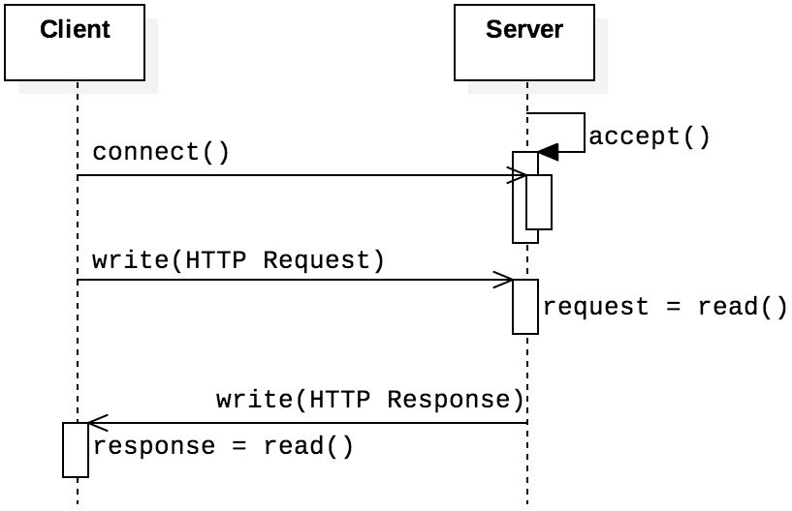
HTTP
Hypertext Transfer Protocol (HTTP) is the protocol for (non-encrypted) web page communication
It's a request-response protocol
  Shown in the sequence diagram on the right
HTTP itself is stateless: no information is preserved between requests
Other features built around HTTP (cookies, server-side scripting, and databases) overcome this stateless limitation

Slide 21
Sample request
HTTP requests and responses start with header lines
  Each ends with CRLF (\r\n), with an extra CRLF after all headers
  Each \r\n would simply look like a newline, but we show them below for clarity
The most common client request is GET
It must have a line like the following:
  path is the file being requested
  version is the HTTP version, usually 1.0, 1.1, or 2
GET /path HTTP/version\r\n
GET /index.html HTTP/1.0\r\n
Accept: text/html\r\n
Accept-Encoding: gzip, deflate, br\r\n
Accept-Language: en-US,en;q=0.5\r\n
User-Agent: Mozilla/5.0\r\n
\r\n

Slide 22
Upcoming

Slide 23
Next time…
Finish TCP socket programming
UDP socket programming

Slide 24
Reminders
Finish Assignment 4
  Due tonight by midnight!
Start on Project 2!
Read section 4.5 and 4.6

